Slide 1


Introduction to Principles of Scientific Evidence
DEPH 312 Principles of Scientific Evidence
Talal Alshihayb ^{BDS, DScD}
Diplomate, American Board of Dental Public Health
Assistant Professor
Department of Preventive Dental Science, College of Dentistry, King Saud bin Abdulaziz University for Health Sciences
Department of Health Policy and Health Services Research, Henry M. Goldman School of Dental Medicine, Boston University
November 26, 2023
shihaybt@ksau-hs.edu.sa

Slide 2

Tell me about yourselves

Slide 3
LECTURE LEARNING OUTCOMES OF EACH OF THE DIDACTIC SESSIONS
LECTURE LEARNING OUTCOMES:
Outline student’s responsibility.
Outline grading system in the course.
Outline the distribution of lectures.

Slide 4
The aim of this course
Equip you with the ability to read and understand scientific studies/papers

Slide 5
Course Structure
This course will have a total
15 lectures
15 interactive/problem-based learning (PBL) sessions
3-4 Exams
First written Intra-semester
Maybe a second written intra-semester
Final practical
Final written
Credit hours: 2
Topics covered:
Science and research
Study designs
Causality
Biostatistics
Scientific writing

Slide 6
Faculty Involved
Dr. Vineet Khinda (course co-coordinator)
Dr. Adeem Alofi
Dr. Sanjeev Khanagar
Dr. Abdulsalam Ali
Dr. Kiran Iyer

Slide 7
Course Outline

Slide 8
Week | Session title | Session type | Date
1 | Introduction to Course | Lecture 1 | 26 Nov
1 | Journal club I | Interactive 1 | 26 Nov
1 | Introduction to science and research | Lecture 2 | 28 Nov
2 | Research Study designs I | Lecture 3 | 3 Dec
 | Journal club II | Interactive 2 | 3 Dec
 | Research Study designs II | Lecture 4 | 5 Dec
3 | Research Study designs III | Lecture 5 | 10 Dec
 | Journal club III | Interactive 3 | 10 Dec
 | Research Study designs IV | Lecture 6 | 12 Dec
4 | Journal club IV | Interactive 4 | 19 Dec
 | Causality in research | Lecture 7 | 19 Dec
 | Foundations of biostatistics I | Lecture 8 | 21 Dec
5 | Foundations of biostatistics II | Lecture 9 | 24 Dec
5 | Journal club V | Interactive 5 | 24 Dec
 | Foundations of biostatistics III | Lecture 10 | 26 Dec
 | First Written Intra-Semester Examination (Lectures 1-7) | Exam 1 | TBA
Lecture
Interactive
Exam

Slide 9
Week | Session title | Session type | Date
6 | Foundations of biostatistics IV | Lecture 11 | 31 Dec
 | Journal club VI | Interactive 6 | 31 Dec
 | Journal club VII | Interactive 7 | 2 Jan
7 | Scientific writing | Lecture 12 | 14 Jan
7 | Journal club VIII | Interactive 8 | 14 Jan
 | Journal club IX | Interactive 9 | 16 Jan
8 | Evaluation of primary studies | Lecture 13 | 21 Jan
 | Searching the literature | Interactive 10 | 21 Jan
 | Using a reference manager | Interactive 11 | 23 Jan
9 | Data analysis I | Interactive 12 | 30 Jan
 | Data analysis II | Interactive 13 | 31 Jan
 | Evidence based dentistry | Lecture 14 | 1 Feb
10 | Research Using Secondary Data | Lecture 15 | 4 Feb
 | Scientific writing I | Interactive 14 | 4 Feb
 | Scientific writing II | Interactive 15 | 6 Feb
TBA | Second Written Intra-Semester Examination (Lectures 8-14) | Exam 2 | TBA
TBA | Final Practical Assessment | Exam 2 | TBA
 | Final Written Comprehensive Examination (Lectures 1-14) | Exam 3 | TBA
Lecture
Interactive
Exam

Slide 10
Lectures’ contents
Number | Title | Topics covered
1 | Introduction to course | Student’s responsibility; grading system in the course; distribution of lectures
2 | Introduction to science and research | Meaning of science; importance of research; hypothesis
3 | Research study designs I | Science of epidemiology; study tasks; measures of disease occurrence
4 | Research study designs II | Measures of association
5 | Research study designs III | Observational and interventional studies; advantages and disadvantage of each study design
6 | Research study designs IIV | Validity and precision in research; random and systematic errors in research
7 | Causality in research | Basics of causality in research; types of causal effects
8 | Foundations of biostatistics I | Variables and their types, distributions; descriptive statistics
9 | Foundations of biostatistics II | distributions; descriptive statistics and different types of distributions
10 | Foundations of biostatistics III | Sampling; sampling techniques
11 | Foundations of biostatistics IV | Statistical paradigms; inferential statistics including p-values and confidence interval
12 | Scientific writing | Scientific writing process; components of a research paper

Slide 11
Lectures’ contents
Number | Title | Topics covered
13 | Evaluation of primary studies | Assessing the different types of study designs
14 | Evidence based dentistry | Evidence-based dentistry; systematic reviews; meta-analyses
15 | Research using secondary data | Sources of data; secondary data; electronic health records for research

Slide 12
Interactive sessions
Number | Title | Topics covered | Format and venue
1 | Journal club I | The scientific system of papers; scientific papers and their components (how to read them) | Just the course coordinator in one classroom
2 | Journal club II | Study tasks and measures of disease occurrence | All faculty in PBL rooms
3 | Journal club III | Measures of association and randomized clinical trials paper I | All faculty in PBL rooms
4 | Journal club IV | Randomized clinical trials paper II | All faculty in PBL rooms
5 | Journal club V | Cohort study paper I | All faculty in PBL rooms
6 | Journal club VI | Cohort study paper II | All faculty in PBL rooms
7 | Journal club VII | Case-control study paper | All faculty in PBL rooms
8 | Journal club VIII | Cross-sectional study paper | All faculty in PBL rooms
9 | Journal club IX | Students choose their own paper to present and discuss | All faculty in PBL rooms
10 | Searching the literature | How to look for papers | Just the course coordinator in one classroom
11 | Using a reference manager | How to use a reference manager (preferably free ones like Zotero or Mendeley) | Just the course coordinator in one classroom
12 | Data analysis I | How to analyze a study | Just the course coordinator in one classroom
13 | Data analysis II | How to analyze a study | Just the course coordinator in one classroom
14 | Scientific writing I | How to write a scientific paper | All faculty in PBL rooms
15 | Scientific writing II | How to write a scientific paper | All faculty in PBL rooms

Slide 13
Grading distribution
Assessment type | % | Assessment format | Assessment task | % | Week due
Continuous | 60% | Theory | First written Intra-semester exam | 15% | 5
 |  | Theory | Second written Intra-semester exam | 0 or 15% | 11
 |  | Practical | Journal clubs and scientific writing | 30 or 45% | Throughout
Final | 40% | Theory | Final written exam | 25% | TBA
 |  | Practical | Final practical exam | 15% | TBA
Continuous practical assessment | %
Journal clubs (average of 9 sessions) | 30% or 25%
Scientific writing (2 sessions) | 15% or 5%

Slide 14
Grading rubric for journal clubs
Criterion | Points
Student presents something about the paper | 4
Student asks questions about the paper | 3
Student answers questions about the paper | 3
Student is absent without an excuse | Automatically gets a 0 for the session

Slide 15
Grading rubric for scientific writing
Criterion | Points
Student writes at least two sections of the methods | 1
Student explains in detail about each section | 1
Student uses appropriate headings and subheading of the sections | 1
Student communicates/writes in a clear scientific language | 1
Student uses correct grammar | 1
Font and its size are appropriate (Times New Roman/Calibri/Arial size 11 or 12) | 1
Student uses appropriate tenses (i.e., future tense for the proposal) | 1
Student uses appropriate punctuation | 1
No spelling mistakes/typos or few (maximum of 1) | 1
General organization (either single space or double space between paragraphs) | 1

Slide 16
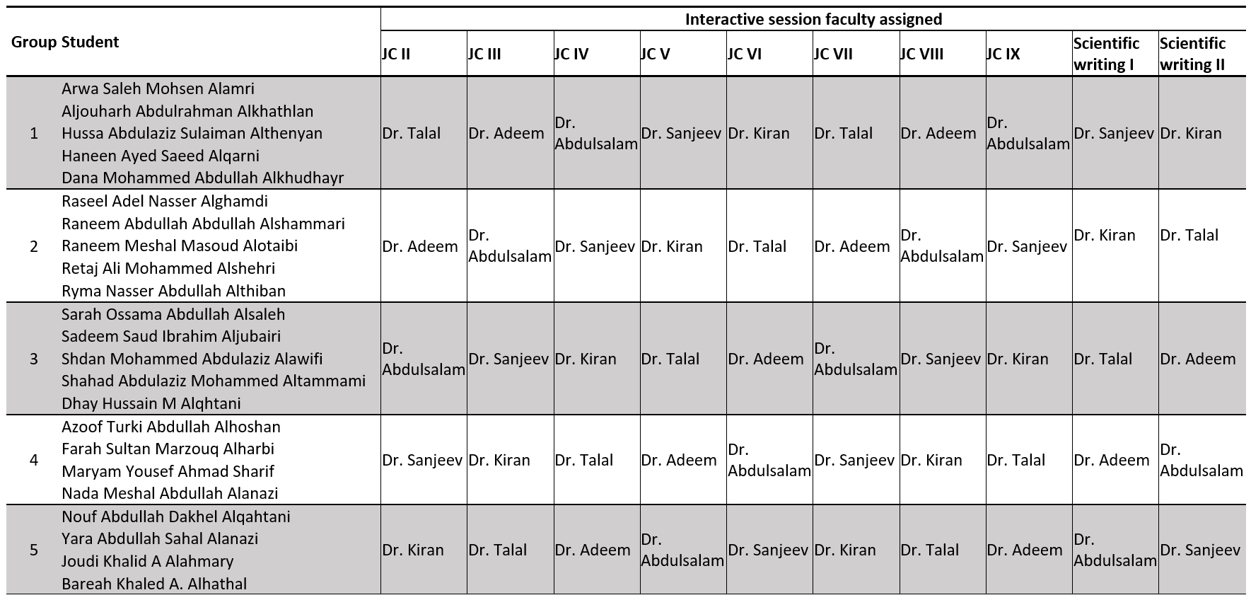
Groups distribution

Slide 17
Your responsibility
Read the coursebook
Read lectures and reference materials
Read papers in advance
Ask questions (especially if you feel lost)
Either during session or email later if you are not comfortable
Make sure you understand the assessments of the course
Attendance to lectures is encouraged but not mandatory from my side
If you can arrange with the student affairs, I am totally fine
Attendance and participation in interactive sessions is mandatory
If you are going to be absent from an interactive session, please send me an email in advance (if you can) with a justification (otherwise send it to me as soon as you can)

Slide 18
Reference materials
Oral epidemiology context:
Burt BA, Eklund SE. Dentistry, Dental Practice and the Community. 7th edition. Philadelphia, PA: W.BSaunders Company, 2020 (Introductory textbook)
Oral Epidemiology A Textbook on Oral Health Conditions, Research Topics and Methods by Richard Watt (Advanced textbook)
General epidemiology context:
Rothman KJ. Epidemiology: an introduction. Oxford university press; 2012 May 4 (Introductory textbook)
Westreich, Daniel. Epidemiology by Design. Oxford University Press. Kindle Edition (Middle textbook)
Modern Epidemiology 4th edition (Advanced textbook)
Surveys and statistical context:
Aday LA, Cornelius LJ. Designing and conducting health surveys: a comprehensive guide John Wiley & Sons; 2006 Apr 14 (surveys, sampling, and questionnaires)
Sampling Design and Analysis 2nd edition (surveys, sampling, and questionnaires)
Statistics from a causal point of view:
The effect: An Introduction to Research Design and Causality by Nick Huntington-Klein https://theeffectbook.net/ (Advanced textbook)
McElreath R. Statistical rethinking: A Bayesian course with examples in R and Stan. CRC press; 2020 Mar 13 (Advanced textbook)

Slide 19
Any Questions?
shihaybt@ksau-hs.edu.sa

